Slide 1

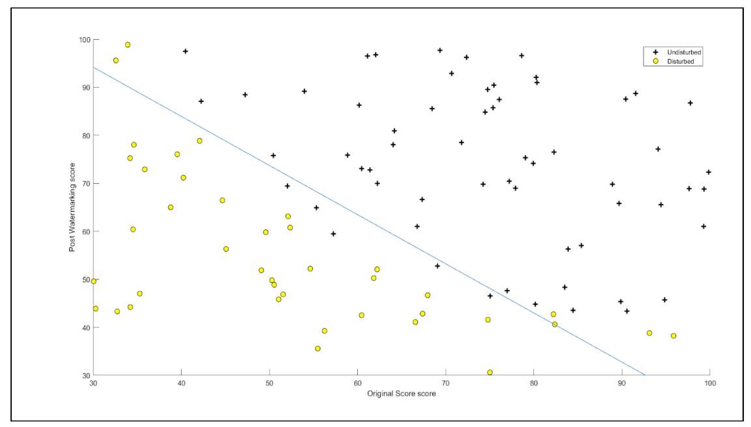
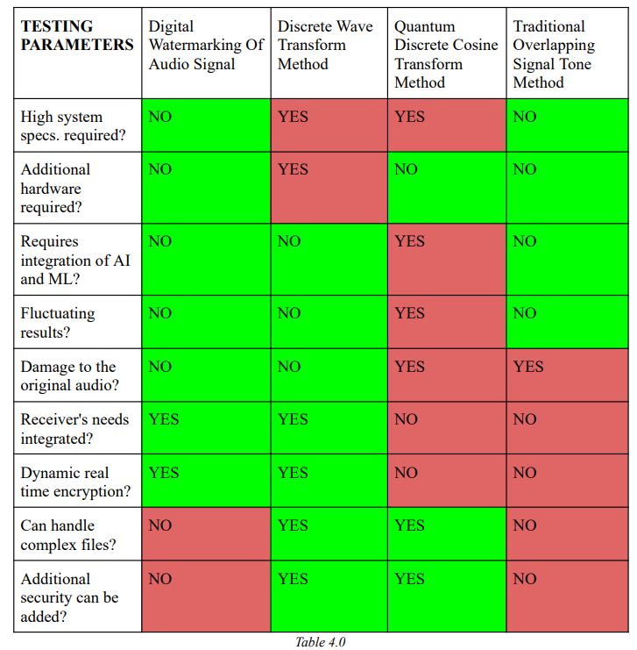
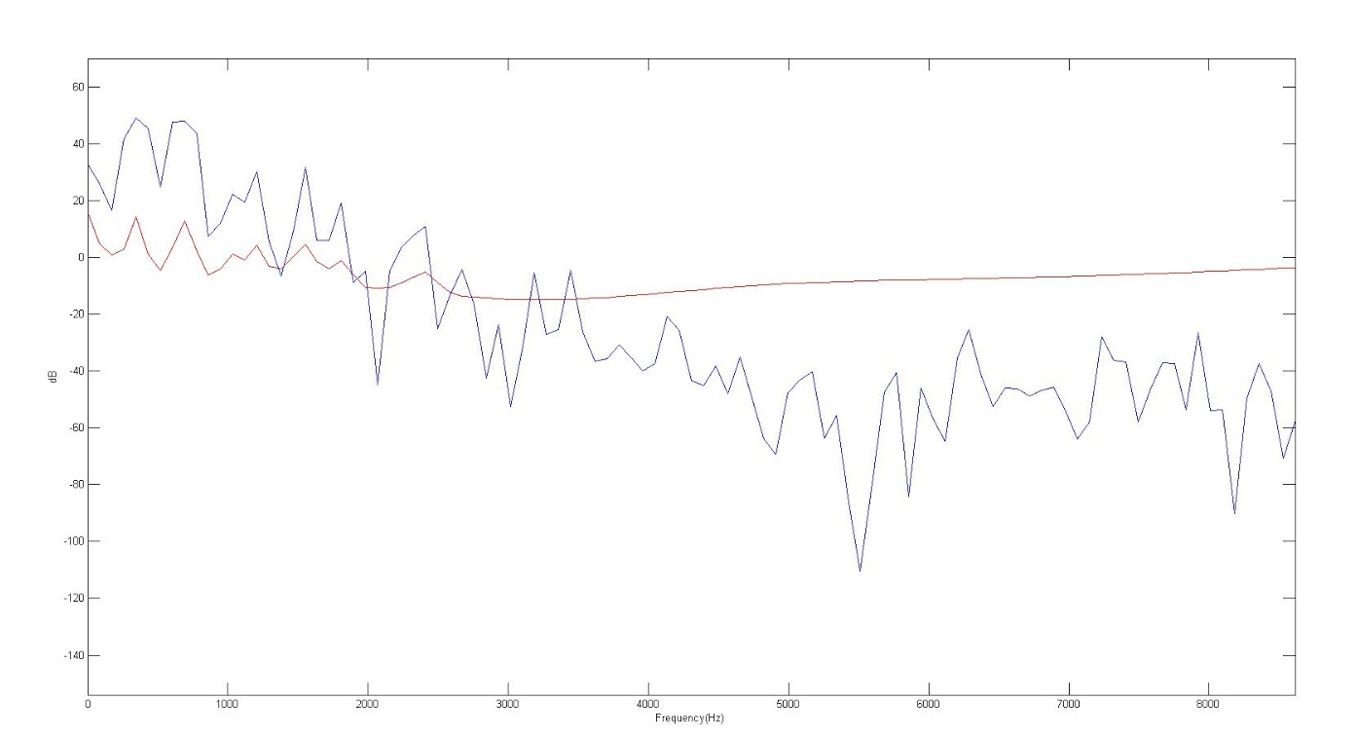
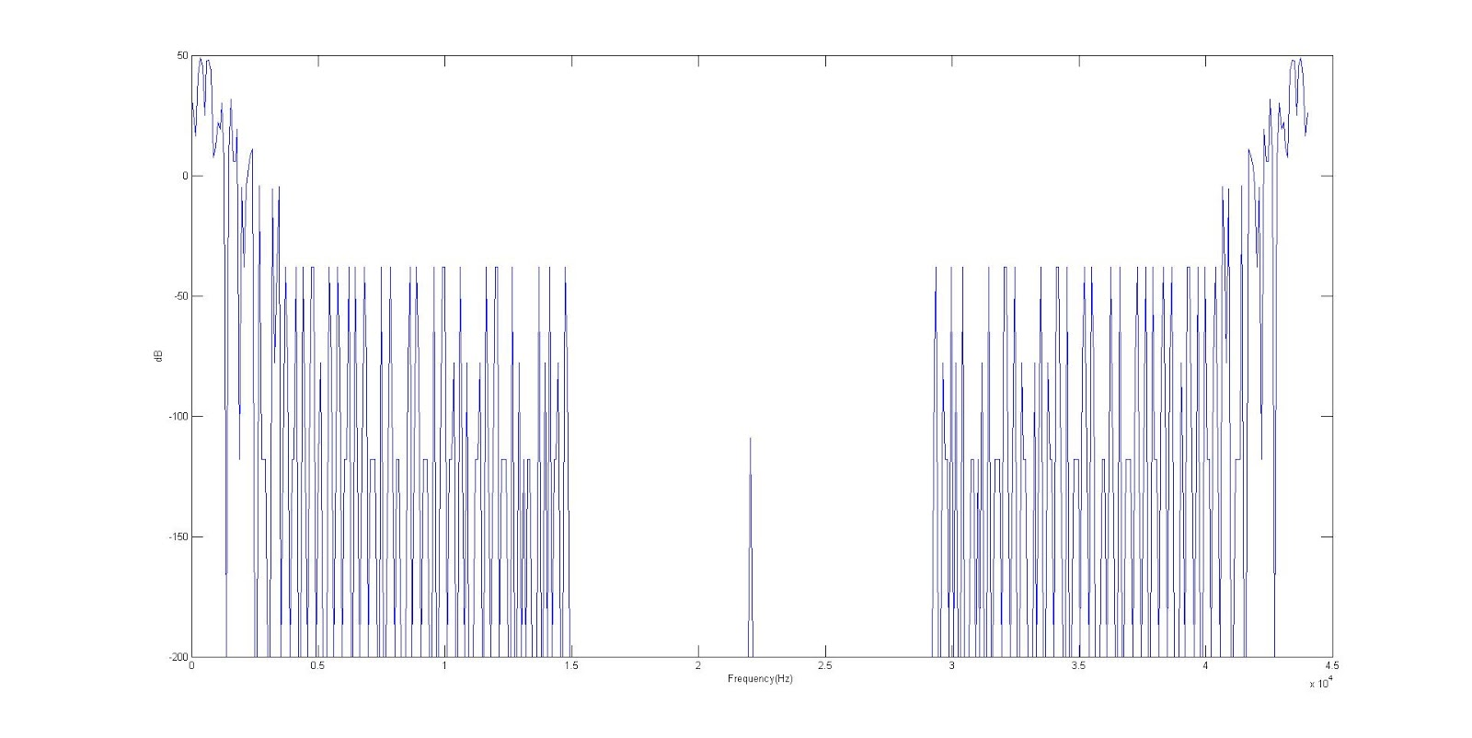
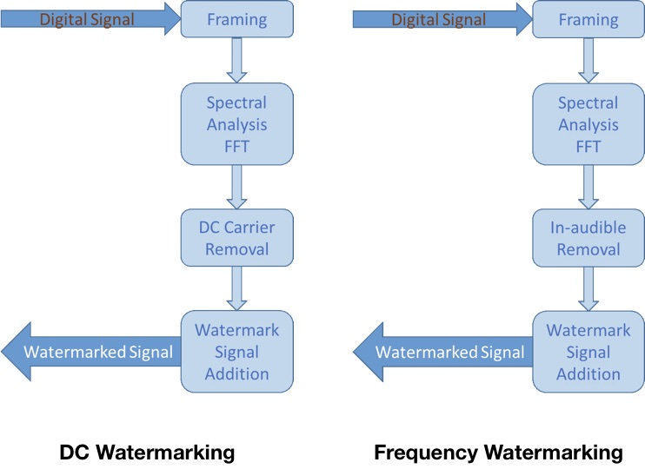
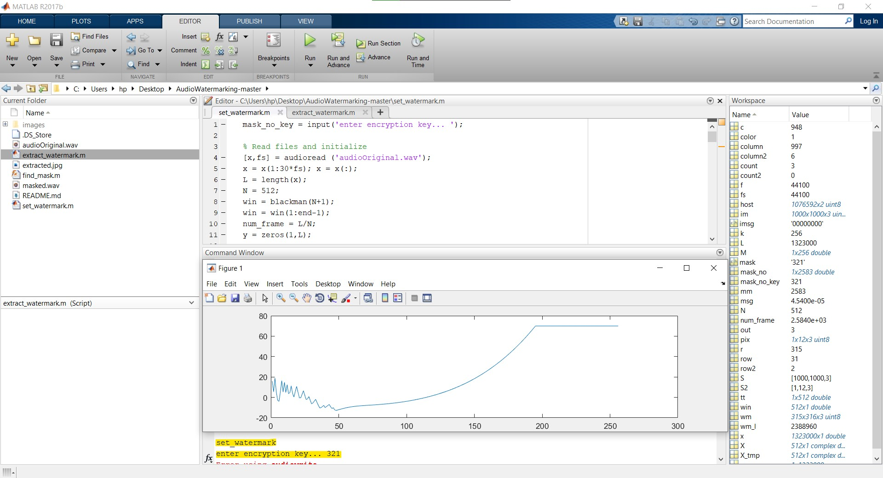
DIGITAL WATERMARKING OF AUDIO SIGNAL FOR ENHANCED SIGNAL PROTECTION
Shruti Shrivastava (RA1811005010271), Gautam Nag (RA1811005010278)
Guide: Dr. C. Naveen
Department of Electrical and Electronics Engineering, SRM Institute of Science and Technology, Kattankulathur
ABSTRACT
In today's world we know the importance of encryption and privacy and with data being the most prized possession it is more important than ever to protect that data. Therefore for our project we are aiming at using this as our principal objective for protecting signal and audio during transmission. To do this will use digital watermarking and using a digital image/unique code superimposing the signal and then transposing that image as a watermark on the audio signal.
COMPARISON
ANALYSIS
Voltage | Average Power | Average Frequency
0.2 | 19.27uW | 834.7MHz
0.4 | 20.21uW | 1.744GHz
0.6 | 19.38uW | 1.956GHz
0.8 | 26.76uW | 2.796GHz
1 | 26.42uW | 2.653GHz
PROBLEM STATEMENT
Our aim to effectively watermark a audio signal y superimposing a digital embedded image onto it. The ed expected result it to obtain a well encrypted watermark that sustains the effectiveness of the original audio file ad maintains its quality.
CONCLUSION
We drew the inference that using this form of audio encryption solves all the 4 disadvantages mentioned in the overlapping method of encryption. For starters not anyone who gets the encrypted audio can decode the audio as the sender has the numbers required to decrypt and extract the watermark. Secondly the sender has total control over the encryption which was not possible in the traditional encryption methods. And lastly the integrity of the original audio signal stays preserved and does not get out of sync or phase, so if we want to send the audio file to a 3rd party we can do so with the watermarked audio intact.
SYSTEM REQUIREMENTS
Windows 7 and above / eq. MAC OS or Linux Minimum 2GB RAM Minimum 2.4 GHz processor. MATLAB (optional)
ALGORITHMIC FLOWCHART
OBSERVATION
METHODOLOGY
DC Watermarking puts the information into the part of music, where the magnitude is lower than the perceptual threshold of human ears. For Frequency Watermarking, since human ear has limit on distinguishing audio frequency, it is possible to find out a frequency loud enough while the frequency near it are rather quiet. Therefore, we replace the frequency band with low magnitude to our information to make the watermark.
Parameters | IEICE 2019 | Ring VCO 2019 | This work
Technology. (nm) | 40 | 90 | 90
Supply (V) | 1.1 | 1.2 | 1
Pavg (mW) | 1.1 | 0.0446 | 0.02642
Oscillation Frequency (GHz) | 1.38 | 1.78 | 2.653
Average Noise (dB/Hz) | -98.05 | -95.15 | -156.7
REFERENCES
M. Davarynejad, S. Sedghi, M. Bahrepour, C.W. Ahn, M. “Detecting Hidden Information from Watermarked Signal using Granulation Based Fitness Approximation", From Theory to Praxis, Springer, Series: Advances in Intelligent and Soft Computing, Volume 58/2009, ISBN 463–472, 2009. M. Davarynejad, C.W. Ahn, J. Vrancken, J. van den Berg, C .A. Coello Coello, "Evolutionary hidden information detection by granulation-based fitness approximation", Applied Soft Computing, Vol. 10(3), pp. 719–729, 2010.

